Slide 1

Object Oriented Programming HTML5 Tutorials Tutorial #1 : Prepare a Bitmap
Department of Computer Science and Information Engineering
Shuo-Han Chen (陳碩漢), shchen@csie.ntut.edu.tw
Hong-Yue Technology Research Building 1223
F 09:10 - 12:00
Notes:
Good Afternoon everyone
I am Shuo-Han Chen, a postdoctoral research fellow at Academia Sinica
It is a great honor to be invited by the department for being here today

Slide 2

Part I.
HTML5 Game Framework 使用說明
Tutorial 1 A : 在畫面中顯示圖片
Notes:
Thank you for listening. Now, I would like to end today’s talk by the Q & A time.

Slide 3
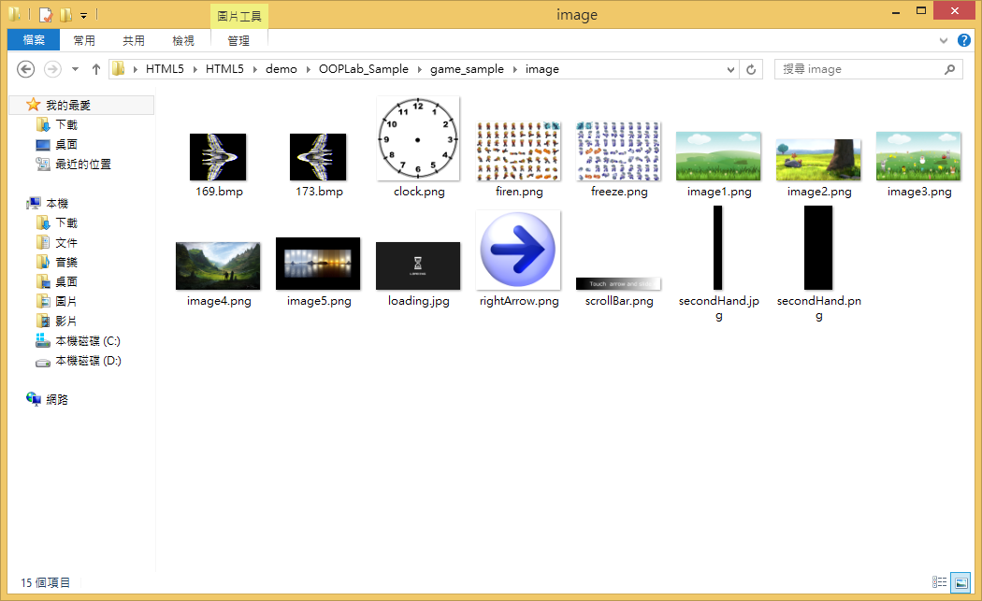
1.打開 HTML5/demo/ OOPLab_Sample
2.準備一張圖片，將圖像檔案，放置在 OOPLab_Sample\game_sample\image 資料夾。

Slide 4
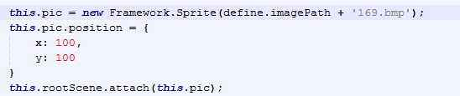
3.宣告圖片物件：打開 game_sample\js 資料夾中的 myGameLevel1.js, 在 load function內宣告如下
Note：在 Html5 Game Framework 中 的圖片 可以 放到 rootScene 上 畫出來

Slide 5
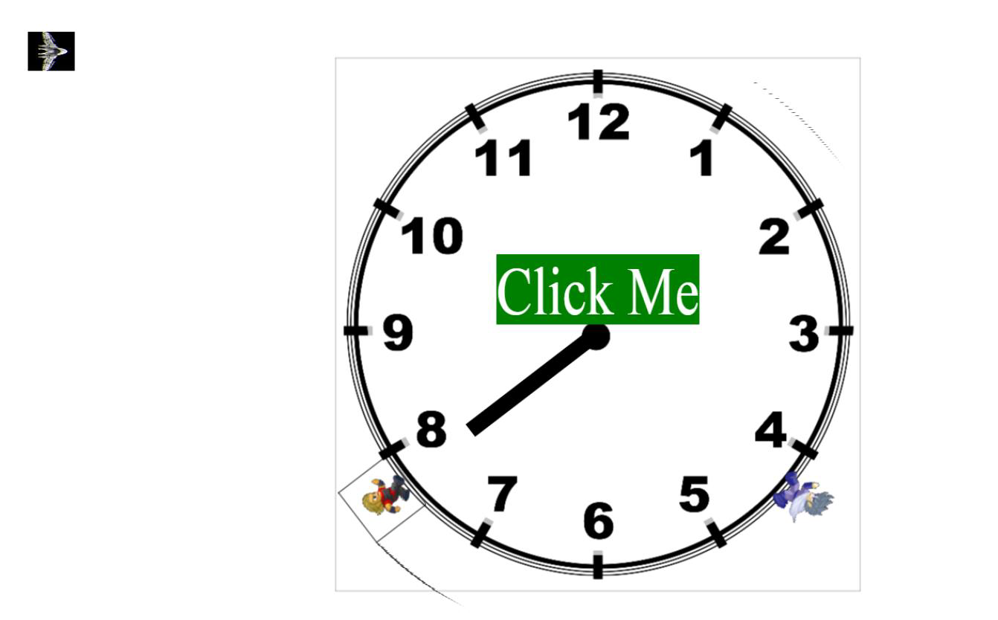
4.執行結果

Slide 6
Part II.
HTML5 Game Framework 使用說明
Tutorial 1 B: 在畫面中顯示圖片
Notes:
Thank you for listening. Now, I would like to end today’s talk by the Q & A time.

Slide 7
1.打開 HTML5/demo/ OOPLab_Sample
2.準備一張圖片，將圖像檔案，放置在 OOPLab_Sample\game_sample\image 資料夾。

Slide 8
3.宣告圖片物件：打開 game_sample\js 資料夾中的 myGameLevel1.js, 在 load function內宣告如下
並在draw function內加入

Slide 9
4.執行結果

